Slide 1


Slide 2

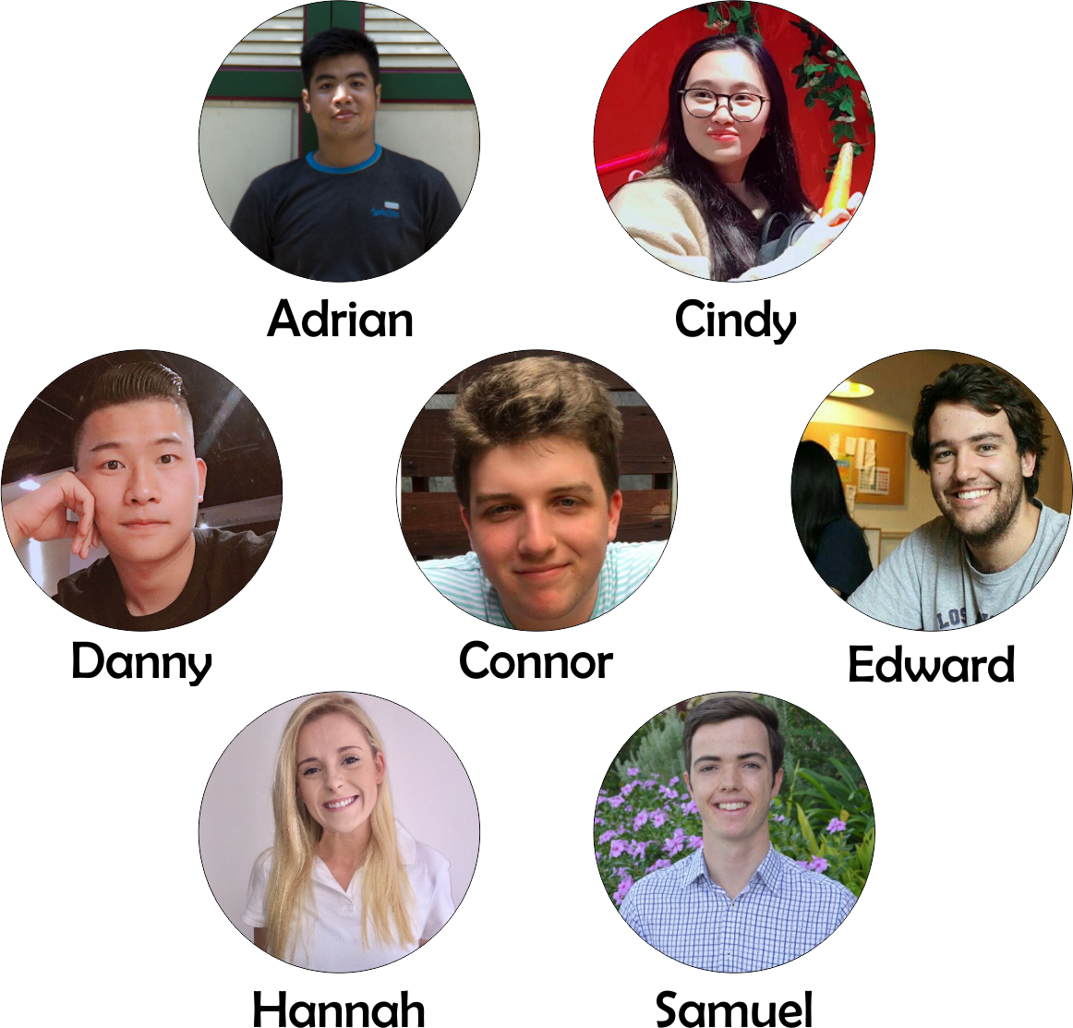
MEMBERS

Slide 3
Easy Travel Diary Creation
See what other travelers are doing
Find basic information for where you’re going
OPPORTUNITIES

Slide 4




ANDROID STUDIO
COREL DRAW
TOOLS
REACT NATIVE
FIREBASE

Slide 5





5
APPS
PAGES
PLAN
DISCOVER
ABOUT ME
MY DIARY
CHAT

Slide 6

See what stories have been published by your friends
DISCOVER

Slide 7

Easy access
to info
Example :
accommodation,
transport and
location
PLAN

Slide 8

MY DIARY
Create private daily diaries
from text and camera roll images (multiple trips)

Slide 9
Send and receive
messages to
friends
CHAT

Slide 10
Store your basic
info for
future use
ABOUT ME

Slide 11

DEMO

Slide 12
GOOD
React Native !
Independent working through Git based on Trello
Firebase
Morning scrum
REFLECTIONS
LESS GOOD
Learning a new language
Combination of Android Studio and React Native
Setting up emulator etc
React native 0.56.0

Slide 13
Automated Diary creation (location tracking, photo dates)
Trip recommendation based on profile
Automatic itinerary generation
FUTURE
DIRECTIONS

Slide 14

THANK YOU
STAY HUNGRY!!!
AROOOOOO

